Slide 1
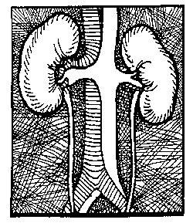

Ace Inhibitors & the Kidneys
A
A
Jameson

Slide 2
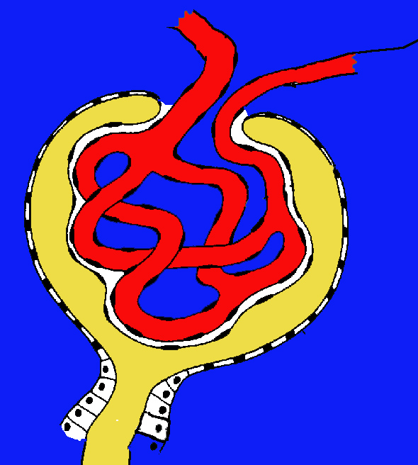
Afferent
Efferent

Slide 3
CHF !
Or Diuretic
RENIN
Drop in perfusion and GFR

Slide 4
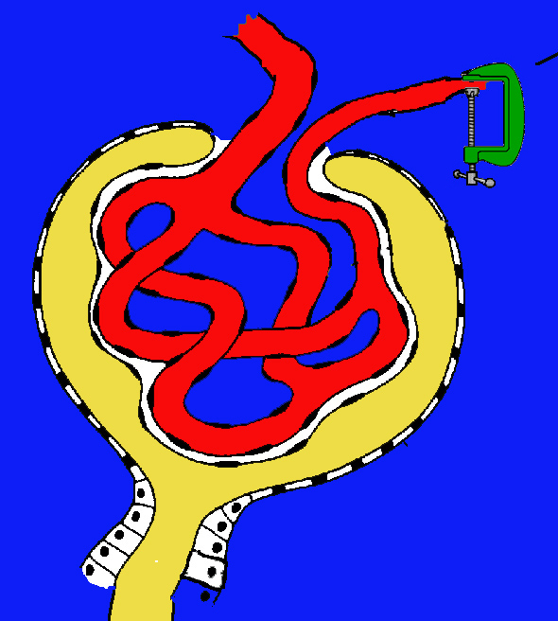
CHF !
Angiotensin II
Vasocontriction
Increases Glomerular Pressure and Filtration

Slide 5
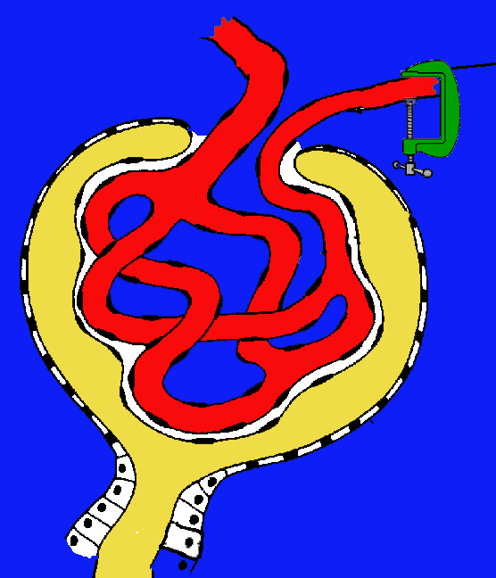
CHF !
CHF !
Angiotensin II
You hope increased C.O. will restore flow
⬆ C.O.
ACE Inh.
Ace Inhibitors
Can reverse this compensatory mechanism and shut down urine output

Slide 6
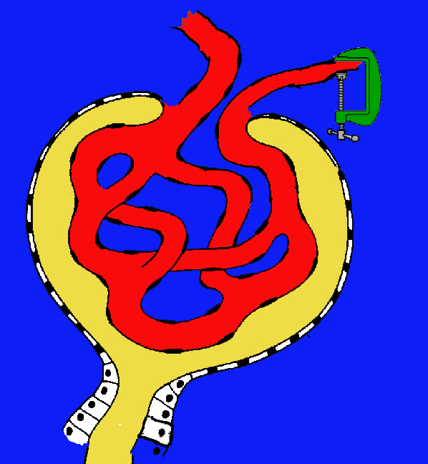
Early Diabetes
Characterized by Hyperfiltration
Normal A II tone

Slide 7
Diabetes post ACE
CHF !
Angiotensin II
Angiotensin constriction removed
Hyperfiltration and damage reduced

Slide 8
CHF w/ renal function
preserved by A II
CHF !
Angiotensin II
Secondary benefit from Prostaglandin dilation on the supply side

Slide 9
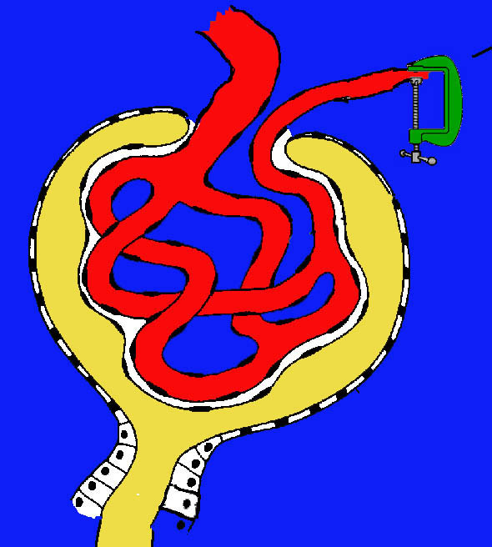
CHF !
Angiotensin II
PG

Slide 10
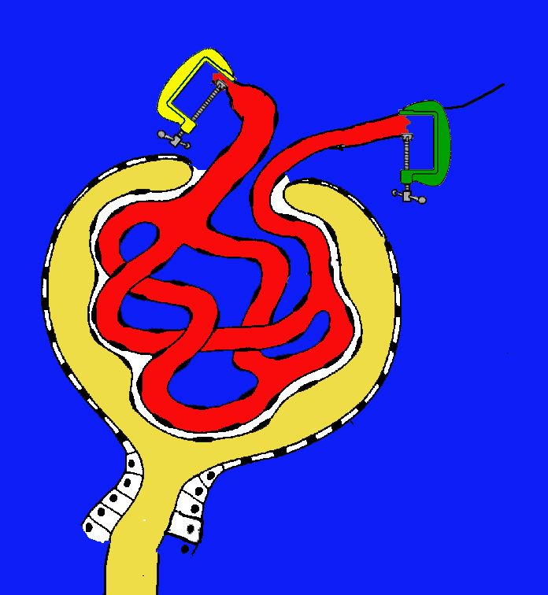
NSAID + ACE
The combination removes both
the Prostaglandin dilation and
the Angiotensin Efferent
constriction
Drip

